Slide 1
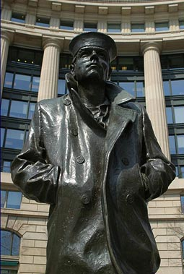
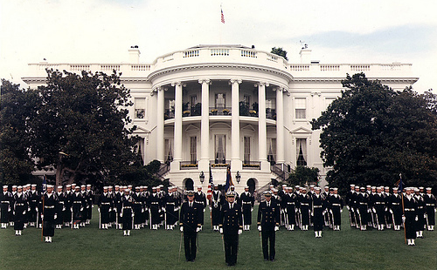
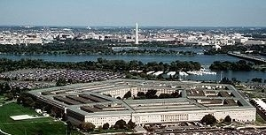
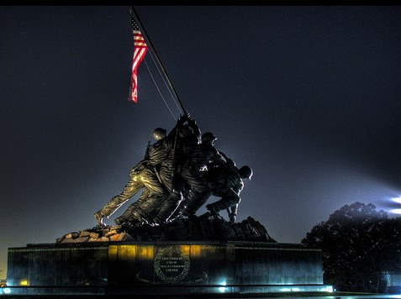

Fleet Logistics Supply Center
Norfolk NDW Postal Division
Official Mail Manager (OMM) Training

Slide 2
OBJECTIVE
Upon completion of this training, personnel will have a basic understanding of Official Mail and the requirements, restrictions on its use, and cost control policies. Personnel will also understand the duties and responsibilities applicable to being assigned as a Unit, Activity, or Command Official Mail Manager.

Slide 3
REFERENCES
Federal Management Regulation, Subchapter G, Part 102-192
DODI 4525.09, DOD Official Mail Management
DOD 4525.8M, DOD Official Mail Manual
OPNAVINST 5218.7 series, Navy Official Mail Management Instruction
NAVSUPINST 5112.1, Postal Management Procedures
USPS Publication 542, Understanding The Private Express Statutes
Service specific and local regulations will provide further guidance for your mailings.

Slide 4
Useful Web Sites
United States Postal Service (USPS)
http://www.usps.com
Military Postal Service Agency (MPSA)
http://hqdainet.army.mil/mpsa/
General Services Administration (GSA)
http://www.gsa.gov
FLCN NDW Mail Center Customer Service Webpage
https://www.navsup.navy.mil/public/navsup/flcn_mail_center/

Slide 5
What is Official Mail?
Matter that pertains solely to the business of the U.S. Government. Official matter becomes official mail once it is postmarked/metered, or is placed under USPS control, which ever comes first.

Slide 6
What is an
Official Mail Manager (OMM)?
Representative for a Command, Activity, or Detachment who is responsible for administration of the Official Mail Cost Control Program (OMCCP) for their Area of Operation (AOR). The OMM is also responsible for the oversight of the activities internal official mail system.

Slide 7
Who can be an OMM
Any commissioned or warrant officer
Any non-commissioned officer (NCO), E-6 or above.
Any civilian (GS) employee (GS-9 (or equivalent) or above).

Slide 8
Assistant OMM
Commands/Activities may appoint an Assistant OMM to perform the OMM duties when the OMM is unable.
Anyone meeting the requirements to be an OMM may be designated as an AOMM.

Slide 9
Appointing an OMM
Installations, units, staff elements, and the DOD Components shall appoint OMMs.
Appointments will be made in writing and shall include the appointees' official mailing address, email address, phone numbers and sample signature.
Appointment letters will be provided to your installation OMM, or next higher command

Slide 10
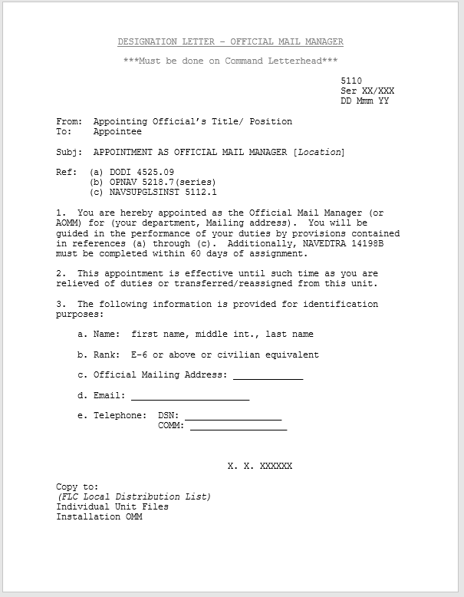
FLEET LOGISTICS CENTER JACKSONVILLE

Slide 11
Understanding the Private Express Statutes
The Private Express Statutes (PES) are a group of federal civil and criminal laws that, for the most part make it unlawful for any entity other than the USPS to send/carry letters over post roads for compensation unless appropriate postage is paid in an amount equal to what would have been paid had the letters been sent through the Postal Service. (USPS Publication 542)
EXAMPLE OF VIOLATION: Mail contractors transporting guard/intra-area mail off base/post to a delivery point in town.

Slide 12
Duties of an OMM (Host)
Serve as the installation single point of contact for tenant commands OMMs.
Inspect all tenant activities mailrooms annually. Copies of these reports shall be filed and made available for review by Regional Mail Manager and during NAVSUP IG visits.
Official Mail Center’s (OMC)/Unit Mailroom (UMR) Inspection Checklist (OPNAV Form 5218/6 (Rev 4/2011) will be used for inspections.

Slide 13
Duties of an OMM (Tenant)
Serve as the commands single point of contact for Instillation OMMs.
Appoints/ Designates Unit Mail Clerks
Review command mailing practices on a regular basis. Ensures command is prepared for annual OMM Program inspection.
Inspect incoming & outgoing official mail for compliance with regulations. Notify mailers of any discrepancies.
Review and approve of all uses of expedited mail services. (FedEx or UPS Overnight etc.)

Slide 14
Duties of an OMM (Host and Tenant)
Familiarize yourself with DOD, local, and service unique instructions.
Maintain current copies of appropriate directives.
Be accessible to Unit mailers to assist and train.
Report misuses of official mail to the Unit Commander.
Security - Safe Guard Command Official Mail

Slide 15
FLEET LOGISTICS CENTER JACKSONVILLE
Designation of Unit Mail Clerks and Mail Orderlies
Prior to entering into mail-handling duties, all
personnel shall receive, at a minimum, training
in:
  The importance of safeguarding mail.
  Handling of accountable mail.
  Timely delivery of mail.
  Consequences for negligence of duty.

Slide 16
FLEET LOGISTICS CENTER JACKSONVILLE
Designation of Unit Mail Clerks and Mail Orderlies (cont)
Commanders or designated representatives (Department Heads, Division Officers or Official Mail Managers) shall designate unit mail clerks, or mail orderlies.
Personnel must meet the qualifications in OPNAVINST 5112.6F and DOD Postal Manual 4525.6-M.
Appointment must be in writing utilizing the “Offenses Against The Mail Statement” (OPNAV Form 5112/1) and a DD Form 285.

Slide 17
FLEET LOGISTICS CENTER JACKSONVILLE
Designation of Unit Mail Clerks and Mail Orderlies (cont)
All mail orderlies and unit mail clerks will sign an Offenses Against The Mail Statement (OPNAV Form 5112/1) and this statement must be kept on file in the post office or mail center
Personnel working in a CMF or other official mail center will be designated as mail clerks not Navy Postal Clerks
Personnel receiving mail direct from a Navy Mail Center, Mail Room, Navy Post Office, or direct from a U.S. Postal Service facility will be designated as mail orderlies

Slide 18
DD – 285s
Mail CLERKS/ Orderlies may be authorized to pick up:
  All Official Mail (Except Accountable)
  All Official Mail (Including Accountable)
Mail Clerks/ Orderlies who are assigned to handle
Official Register Mail:
    Must be eligible for a SECRET security clearance.
    Cards MUST be shown at time of delivery to sign for mail
FLEET LOGISTICS CENTER JACKSONVILLE

Slide 19
Official Mail Search and Seizure
USPS inspections, search procedures, and postal laws apply to official matter only while it is mail.
OMM’s and assistant OMMs may inspect outgoing official mail items either before they are postmarked by a postage meter, or when using stamps or permits, or before the material is placed under control of the USPS or its representative, whichever occurs first.

Slide 20
AUTHORIZED USES OF APPROPRIATED FUND POSTAGE
Material relating solely to the business of the U.S. Government.
Review the DOD 4525.8M Official Mail Manual for a detailed listing

Slide 21
Unauthorized Use for Official Mail
(Some examples of prohibited items)
Material not relating solely to the business of the government.
Information by DOD components about non-mandatory events.
Invitations to social functions to satisfy personal social obligations, even if they’re the result of an official position.
Review regulations for a complete overview of unauthorized uses.
Matter donated by individuals for donation to other individuals or charitable organizations (care packages).

Slide 22
Cost Reduction Tips
Ask the following about all mailings:
What will happen if item isn’t mailed?
What if these are mailed less frequently?
Is our address listing up to date?
Could another, less expensive method of transportation be used for this material… FEDEX ground or UPS
Can it be consolidated with other material going to the same address?
Can costs be reduced by reducing size or weight of the item?
Limit the use of Business Reply Mail and special services such as Registered Mail, Certified Mail, and Return Receipts. The rule for special services is they only be used when it’s required by regulation or law.

Slide 23
Cost Control Initiatives
Limit the use of USPS mailing container.
Do not accept items presented for mailing in the USPS FLAT RATE or PRIORITY ENVELOPE.
Instruct customers to use standard flat envelopes, mail center personnel will endorse it first class if less than 13 ounces and priority for items over 13 ounces.
Ensure mail clerks are familiar with the USPS FLAT RATE BOXES and the difference between them and the PRIORITY boxes.
FLAT RATE BOXES are to be used only when the cost of mailing would exceed the cost if mailed in regular containers.

Slide 24
Cost Control Initiatives
Flat envelopes are defined as a mail piece exceeding one of the dimensions for letter-size mail, pieces weighing 1 oz. or less is subject to a non-machinable surcharge of $0.20. Use flat envelopes only when:
  The thickness of the contents and envelope would exceed ¼ inch if folded and place in a letter-size envelope.
  The envelope and its contents weigh more than one ounce when first class mail is used.
  The contents will be damaged by folding

Slide 25
Cost Control Initiatives
Letter size envelopes can hold four sheets of paper and shall be used whenever possible, letter size envelopes are defined as a mail piece including cards not exceeding 11-1/2 inches long, 6-1/8 inches high and ¼ inch thick. (Note: It must be at least 5 inches long, 31/2 inches high.)

Slide 26
Material that cannot be sent via the mail
Some items/material aren’t allowed in the mail system.
Items that may cause injury to life, health or property are non-mail able.
Unless otherwise specified, any article that can kill or injure another, injure mail or other property (flammable, explosive etc. ) is non-mailable.

Slide 27
Penalty for Private Use of Official Mail
Under Title 18 U.S. Code Chapter 31 Sections 641 - The provisions for fine of not more than $1,000 or imprisonment of not more than 1 year for an offense involving $1000 or less.
A fine of not more than $10,000 or imprisonment of not more than 10 years, or both applies to offenses in excess of $1000.

Slide 28
Protection of Mail
Security of the Mail is everyone's responsibility. Command OMM’s need to provide for the protection of the mail in their control against loss or theft.
Designated personnel shall deliver mail only to the addressee or authorized agents.
Mail received into the hands of an addressee or addressee’s agent is considered properly delivered mail.
Mail addressed to employees or officials of an organization at the organization’s address is considered properly delivered after it’s received at the organization.
For this reason, the Postal Inspection Service discourages staff from using their employer’s address to receive personal mail.

Slide 29
Personal Mail
An activity’s employees shall not receive personal mail or send outgoing personal mail through the Official Mail Center.
Mail bearing an attention line or job title is considered official and shall be delivered.
Review DoD 4525.8-M for further details regarding personal mail.

Slide 30
Addressing Standards
Rubber stamps frequently create unreadable addresses and shall not be used for either return or delivery addresses.
Delivery addresses must be typed or printed by other mechanical means.

Slide 31
Address Format
Addresses shall have a minimum of three lines, but not more than five lines.
Each address line will be limited to a maximum of 40 characters
Use the proper 5 digit zip code. Use the appropriate nine digit zip+4 if known.

Slide 32
SAMPLE RETURN ADDRESS FORMAT
DEPARTMENT OF THE NAVY
COMMANDING OFFICER
ATTN: CODE 415
FLCN NAVAL DISTIRCT WASHINGTON
1013 O STREET SE
WASHINGTON NAVY YARD DC 20374-5014
OFFICIAL BUSINESS
DEPARTMENT OF THE NAVY
TITLE LINE
OPTIONAL LINE
NAME OF ACTIVITY
DELIVERY ADDRESS
CITY STATE ZIP+4 CODE
OFFICIAL BUSINESS

Slide 33
DIRECTORY/ REDIRECT MAIL
OFFICIAL MAIL is addressed to Your Command, not to a private individual.
Remember:
  Names in Attention lines mean “Official”
  Names with a Title mean “Official”
  The only reason Official Mail will be returned to sender is if it is refused by the Command/ Org. it is addressed to.
The following slides show the procedures for returning mail that is refused or missent

Slide 34
EXAMPLE OF RETURN TO SENDER
FRONT OF MAIL
Customer MUST annotate a circle with the letters “RTS” directly to the left side of address ( It can be noted to the right or above ONLY IF there is no room to the left)
Customer MUST line through address (single line from top left to bottom right of address) and mark out barcodes completely.
RTS
IIIIIiiIIIIIIIiiiiiiIIIIIiiiiIIIIiIII

Slide 35
EXAMPLE OF RETURN TO SENDER
BACK OF MAIL
Mail Clerk will make these annotations on the backside. The ONLY time a piece of Official Mail will be RTS’ed is if it is refused. There should be no other reason for returning Official Mail.
Name of command
Date Rcvd____________
Date fwd_____________
Reason______________
Clerk Int/ Card#________
JKB/ 4-22
10 Jul 19
11 Jul 19
Refused
IIIIIiiIIIIIIIiiiiiiIIIIIiiiiIIIIiIII

Slide 36
EXAMPLE OF MISSENT
FRONT OF MAIL
Customer MUST circle the address to indicate mail was missent. No other markings are to be made to the front of the mail.
IIIIIiiIIIIIIIiiiiiiIIIIIiiiiIIIIiIII

Slide 37
EXAMPLE OF MISSENT
BACK OF MAIL
Mail Clerk will make these annotations on the backside indicating Missent as the Reason. Return to the following Business day to the Official Mail Center
Name of command
Date Rcvd____________
Date fwd_____________
Reason______________
Clerk Int/ Card#________
JKB/ 4-22
10 Jul 19
11 Jul 19
Missent
IIIIIiiIIIIIIIiiiiiiIIIIIiiiiIIIIiIII

Slide 38
Accountable Mail (Certified)
Only available for 1st Class or Priority mail
Addressee must sign for certified when it’s delivered.
Authorized for use when mailing:
  Adverse Officer or Enlisted Performance Reports.
  Dishonored Checks
  Traffic Tickets
  EEO Material
  Controlled Test Material
  Court Summons/Subpoenas
See DoD 4525.8-M for complete list and FLCN NDW Customer Service Guide for procedures on preparing for shipment

Slide 39
Accountable Mail (Registered)
This is the most secure method of mailing
Slowest moving mail
Expensive
Authorized for use when mailing:
  Any Secret Material
  Confidential Material traveling to an APO/FPO address
  Mail government firearms
  Criminal Investigation Evidence
  Cash
See DoD 4525.8-M for complete list and FLCN NDW Customer Service Guide for procedures on preparing for shipment

Slide 40
FLCN NDW Customer Service Guide
For additional information on:
Cost Reduction
Mail Security
Mail Classification
Mail Preparation for shipping (Ordinary and Accountable)
Please review FLCN NDW Customer Service Guide which can be found at https://www.navsup.navy.mil/public/navsup/flcn_mail_center/

Slide 41
RECOGNIZING SUSPICIOUS MAIL
The following are some characteristics detected over the years which should trigger concerns that material may be suspicious:
  An item is either unexpected or from someone unfamiliar to the addressee
  Mail received addressed to someone no longer within the organization
  A parcel with either no return address, or one that can’t be verified as legitimate

Slide 42
RECOGNIZING SUSPICIOUS MAIL (cont.)
  An item is of an unusual weight, lopsided, rigid, or oddly shaped.
  An article bears restrictive markings like “Personal For” “Confidential” “Rush Do Not Delay”, or “Fragile Handle with care”
  Oily stains, powder, or residue on the packaging.
  Protruding Wires

Slide 43
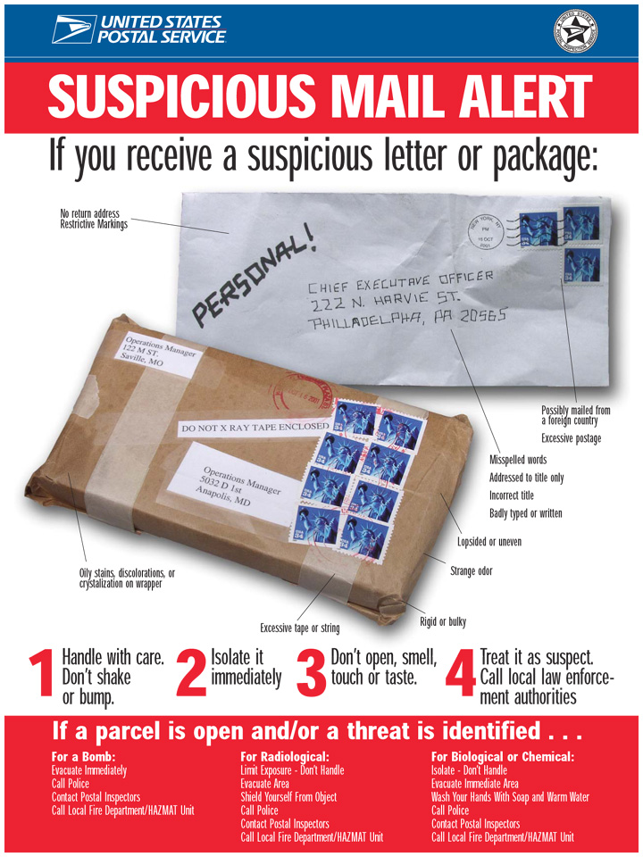

Slide 44
SUSPICIOUS MAIL
SECURITY MEASURES
The best defense against explosive devices, chemical, or biological hazards suspected of being received in the mail system is having knowledgeable and informed employees, exercising a level of common sense.
If a suspicious item is found isolate it if possible, clear the area, and notify local authorities.

Slide 45
In addition to this training, OMM’s must successful complete of the Navy’s Correspondence Course within 4 months of appointment:
  ON SITE, PROVIDED BY THE SERVICING MAIL FACILITY
  ONLINE VIA NAVY E-LEARNING (NeL) https://learning.nel.navy.mil
  3. COURSE: Command Official Mail Training Manual
    FOR ENROLLMENT GO TO:
    Course Catalog tab
    Click the 'Navy Rate Training Courses'
    Click Service Support search for or enter course number and name:
    Prefix: NETC
    Course # NRTC-NAVEDTRA-14198B-COMTM-1.0
    Title: Command Official Mail Training Manual

Slide 46


CERTIFICATE OF COMPLETION
THIS CERTIFICATE CERTIFIES THAT
JENNIFER D STARKS
HAS SUCCESSFULLY COMPLETED
The NAVSUP FLC Norfolk, NDW
Official Mail Manager Training
03 MAR 20
DATE
SIGNATURE
NAVSUP Fleet Logistics Center Norfolk, NDW

